Slide 1
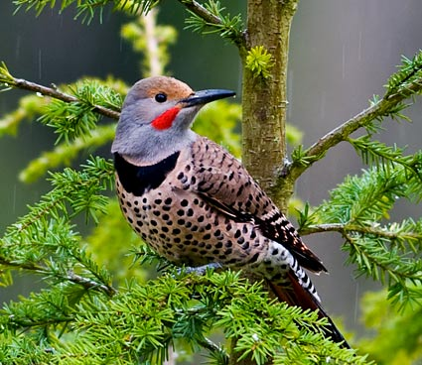
Bird Biology and Ecology
Northern Flicker
I. Ornithology is the Science of the Study of Birds
(http://www.youtube.com/watch?v=myuNrP8ETSE

Slide 2
Origin and Evolution of Birds
(Refer to Evolution of Birds Chart)
II. Evolved 155 million years ago (mya)
During the Mesozoic geologic era, Jurassic
period
Evolved from reptiles, Theocodontia, 200 million years ago (mya).
Archeopteryx, the oldest bird fossil, found in rock quarry in Bavaria in 1800’s. (The Free State of Bavaria is a state of Germany, located in the southeast. it is the largest state by area, forming almost 20% of the total land area of Germany. Bavaria is Germany's second most populous state)

Slide 3
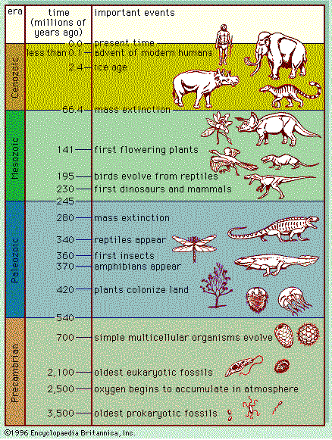

Slide 4
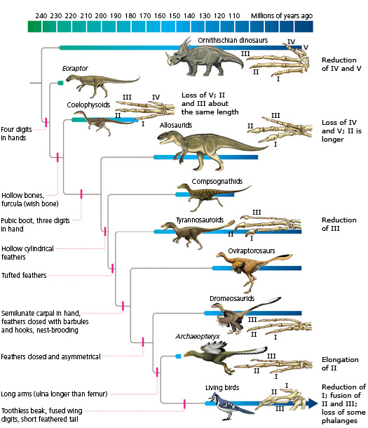

Slide 5
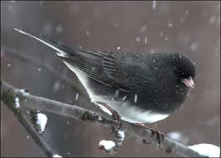
Dark-eyed Junco

Slide 6
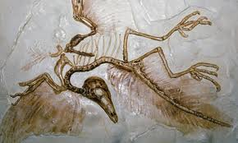
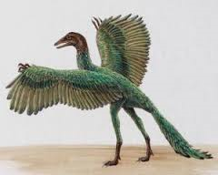
Archeopteryx - Archaeopteryx, sometimes referred to by its German name Urvogel, is a genus of early bird that is transitional between feathered dinosaurs and modern birds. (approx. size of turkey)

Slide 7
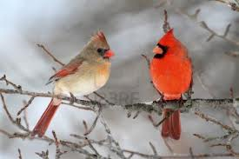
Female and Male Cardinals
Female and Male Cardinals

Slide 8
Biological Characteristics
III. A. Bones are hollow for flight.
Contain air cavities besides lungs for efficient respiration.
Birds have air sacs that act as auxiliary lungs
Each breath a bird takes is much more concentrated than an equivalent human breath.
B. Body Covering: feathers.
http://www.birdwatching-bliss.com/bird-feathers.html
C. Body Temperature: warm-blooded.
*Note: The only other animal group, besides birds, that maintains a constant body temperature as external temperature changes: mammals.
D. # of pairs of wings: 1___

Slide 9
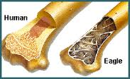
Human vs. Bird Bones
Hollow bones reduce drag and the natural curve
of the wings creates significant lift.
https://www.youtube.com/watch?v=4jKokxPRtck “How Birds Wings Work, (Compared to Airplane Wings)”

Slide 10
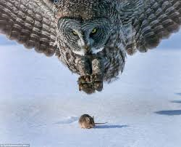
E. Mouth: beak on bill Teeth: none
F. Structure in upper chest/throat area for grinding and storing food: crop/gizzard.
G. Eyesight: excellent (Hawks and owls can see details of an insect at 100 yards)
https://www.youtube.com/watch?v=f-V_nNqDVxw

Slide 11
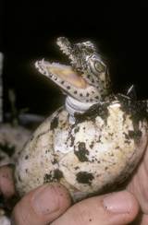
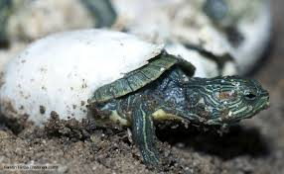
H. Single body opening for both reproduction and excretion of liquid and solid wastes: cloaca.
I. Eggs: Hard-shelled in order to conserve moisture as young develop outside body in nest.
*(Note: Soft-shelled eggs of reptiles (snakes, turtles, etc.) must be buried or otherwise protected from moisture loss.)

Slide 12
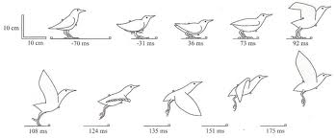
J. Metabolic Rate: High in order to supply
energy for flight.
For birds, flying is an incredibly taxing exercise.
Some bird experts compare it to human jogging
times ten. https://www.youtube.com/watch?v=jc9En9WUzI8 Owl landing
https://www.youtube.com/watch?v=B1uY7_wdYOA Birds take off
https://www.youtube.com/watch?v=VSzpM8vEAFA Pigeons take off

Slide 13
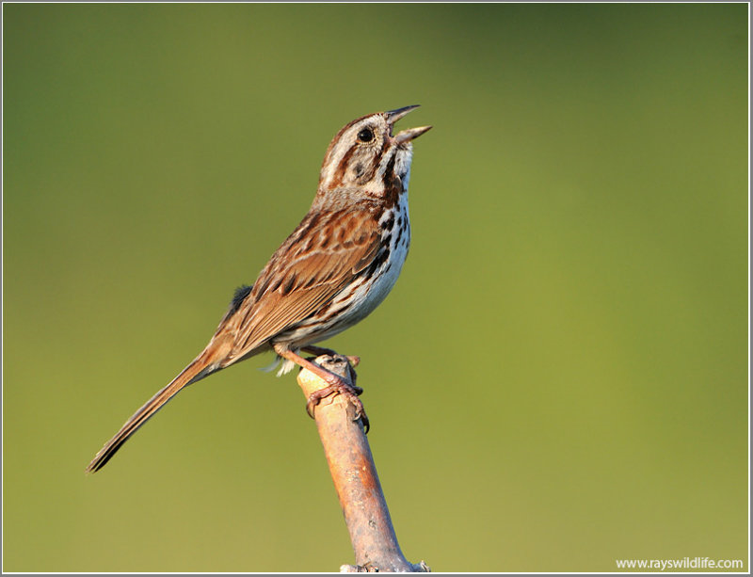
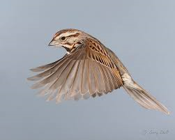
Birds also have very well-developed pectoral muscles for constant wing motion and an exceptionally strong heart for endurance.
Most birds are literally swimming through the air, using the weight of the air beneath them to keep them aloft. Song Sparrow

Slide 14
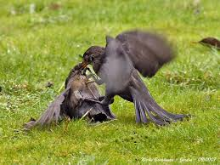
IV. Bird Behavior:
A. Territorial: Battles over feeding and nesting.
Territorial behavior between two female Common Blackbirds.
https://www.youtube.com/watch?v=eI_quJRRGxk Moon-walking bird. (Matakin)

Slide 15
B. Reproductive: Courtship, choosing mates.
Nesting, caring for eggs/feeding hatchlings.
Fledging, teaching young to fly.
C. Migratory: 1. Birds begin their migration in
response to changing “length of daylight”
or photoperiod.
https://www.youtube.com/watch?v=EJ0AMsyc15I Microlight pilot Christian Moullec went to extraordinary lengths in order to film birds in flight from up close. He hand-reared a brood of Barnacle Geese who now see him as their mother and follow him in flight.
https://www.youtube.com/watch?v=2EAIZ36h55Y Ornithologist taught birds new migration paths to safe havens.

Slide 16
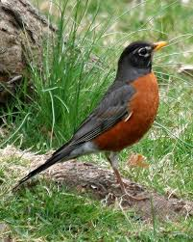
2. Reason for Migration: Insect eaters fly
South in Late Summer/Early Autumn, since
this food supply is scarce or not available in
Winter.
Robin
http://www.learner.org/jnorth/tm/spring/InsectEaters.html
(Northern Insect-eating Birds)

Slide 17
C. 2. Mostly seed-eaters remain in Northern Latitudes throughout the year. Woodpeckers are one exception due to their ability to obtain insects from trees.
3. Migratory Flyway used by birds in our region to travel South for Winter:
Great Lakes/Eastern Flyway.

Slide 18
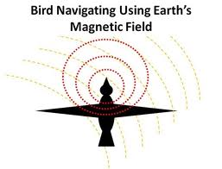
4. FIVE methods used by migratory birds to navigate along flyways.
  A. Sun angle
  B. Follow Earth’s magnetic field
  C. Use Star Constellations at night
  D. Follow Landmarks (Coastlines/Mt. Ranges)
  E. Follow Sound Waves

Slide 19
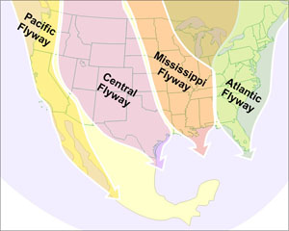
http://www.fws.gov/alaska/nwr/arctic/birdmig.htm (animated map with bird examples)
http://www.ducks.org/conservation/where-we-work/flyways
Artic National Wildlife Refuge

Slide 20
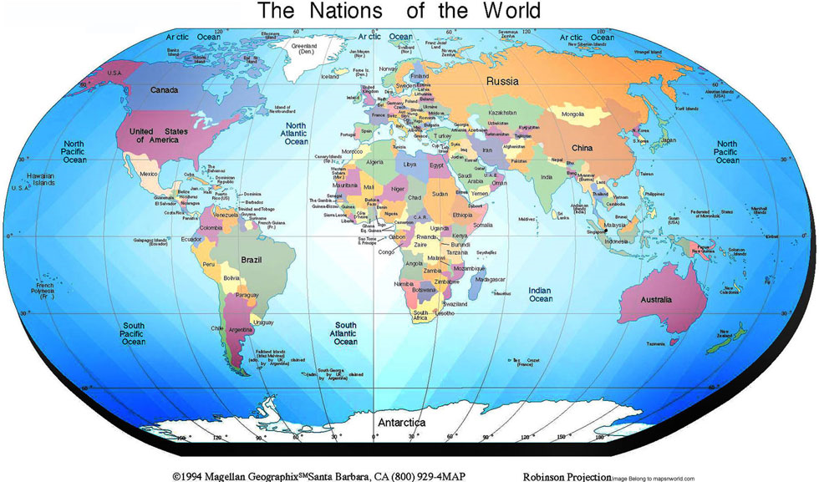
http://www.borealbirds.org/birdguide/mig_map_main.shtml
Boreal Songbird Initiative (Interactive map- click bird picture)

Slide 21
V. Bird Classification & Populations:
        Kingdom: Animalia
        Phylum: Chordata
        Subphylum: Vertebrata
        Class: Aves
        North America World
        # of Orders 20 27
        # of Species 700 8600
        Total Estimated
        Population 20 Billion 100 Billion

Slide 22
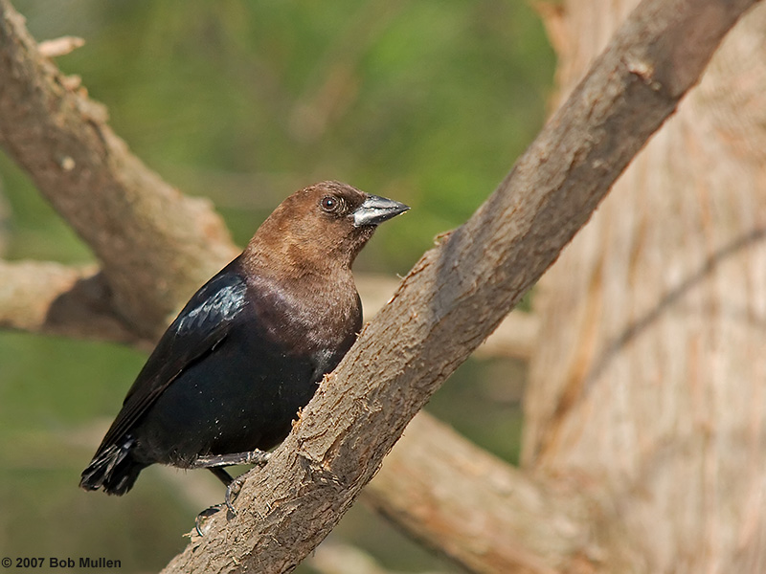
* Note: The largest ORDER of Birds in
North America, containing 27 FAMILIES:
Passeriformes (Perching Birds)
http://www.pbase.com/bmullen/small_perching_birds
Brown- headed
Cowbird

Slide 23
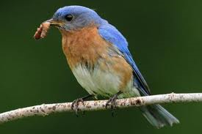
VI. Ecological Importance of Birds:
    A. Distribution of Plant Species
    (Seeds, Pollen, Spores)
    B. Pest Insect Control
    (Ex. Family of Eastern Bluebirds may eat
    1000 caterpillars in one day!)
    C. “Ecological Barometer”
    (Birds are sensitive to pollution from
    pesticides and toxic waste)

Slide 24
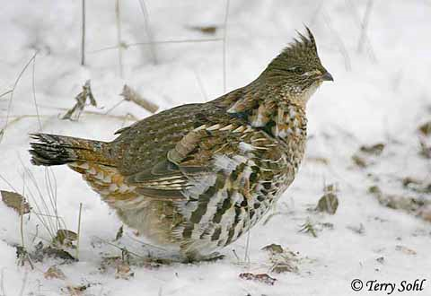
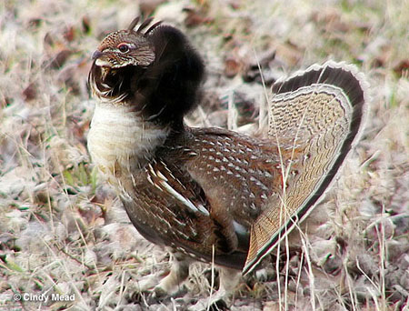
Common Name Genus/Species
**Pa State Bird: Ruffed Grouse Bonasa Umbellos

